Slide 1
PSYC 330 Final Prototype:
The Button-Pusher
Jessica Barta

Slide 2
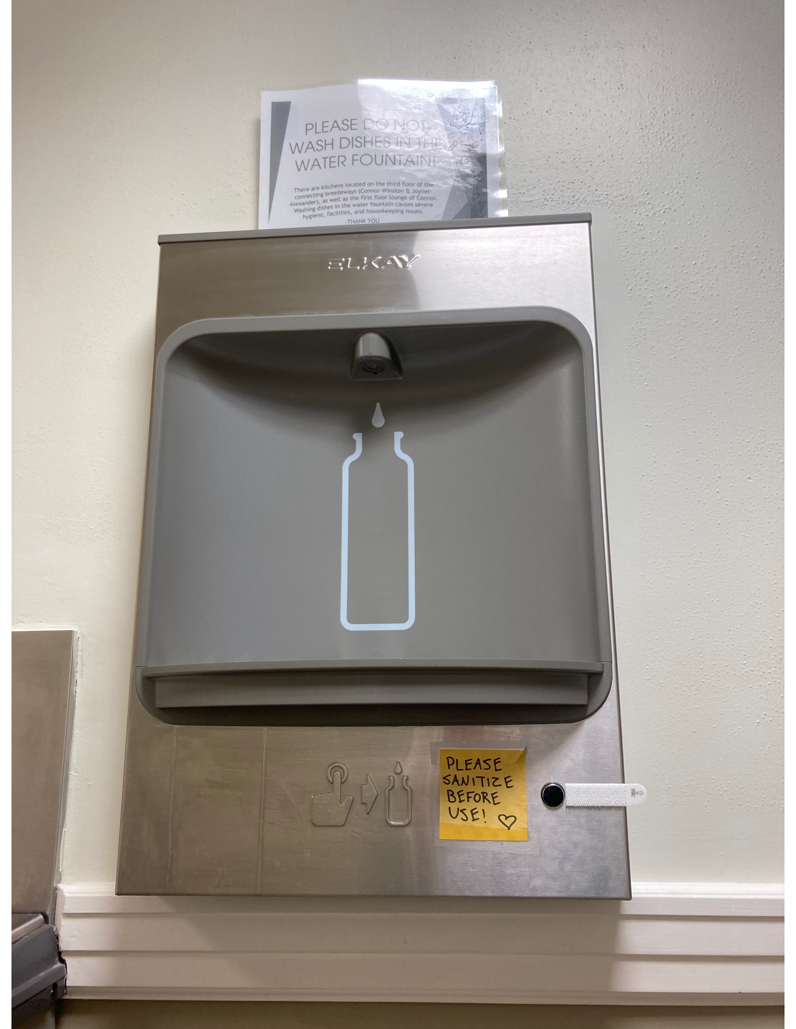
The Problem
Button used to dispense water is difficult to press
Pressing the button with a pointer finger (per the diagram) causes pain
Upgrading the bottle filler to a touchless model is not an option so an inexpensive solution is needed
Product must be removable because water bottle filler is property of Carolina Housing

Slide 3
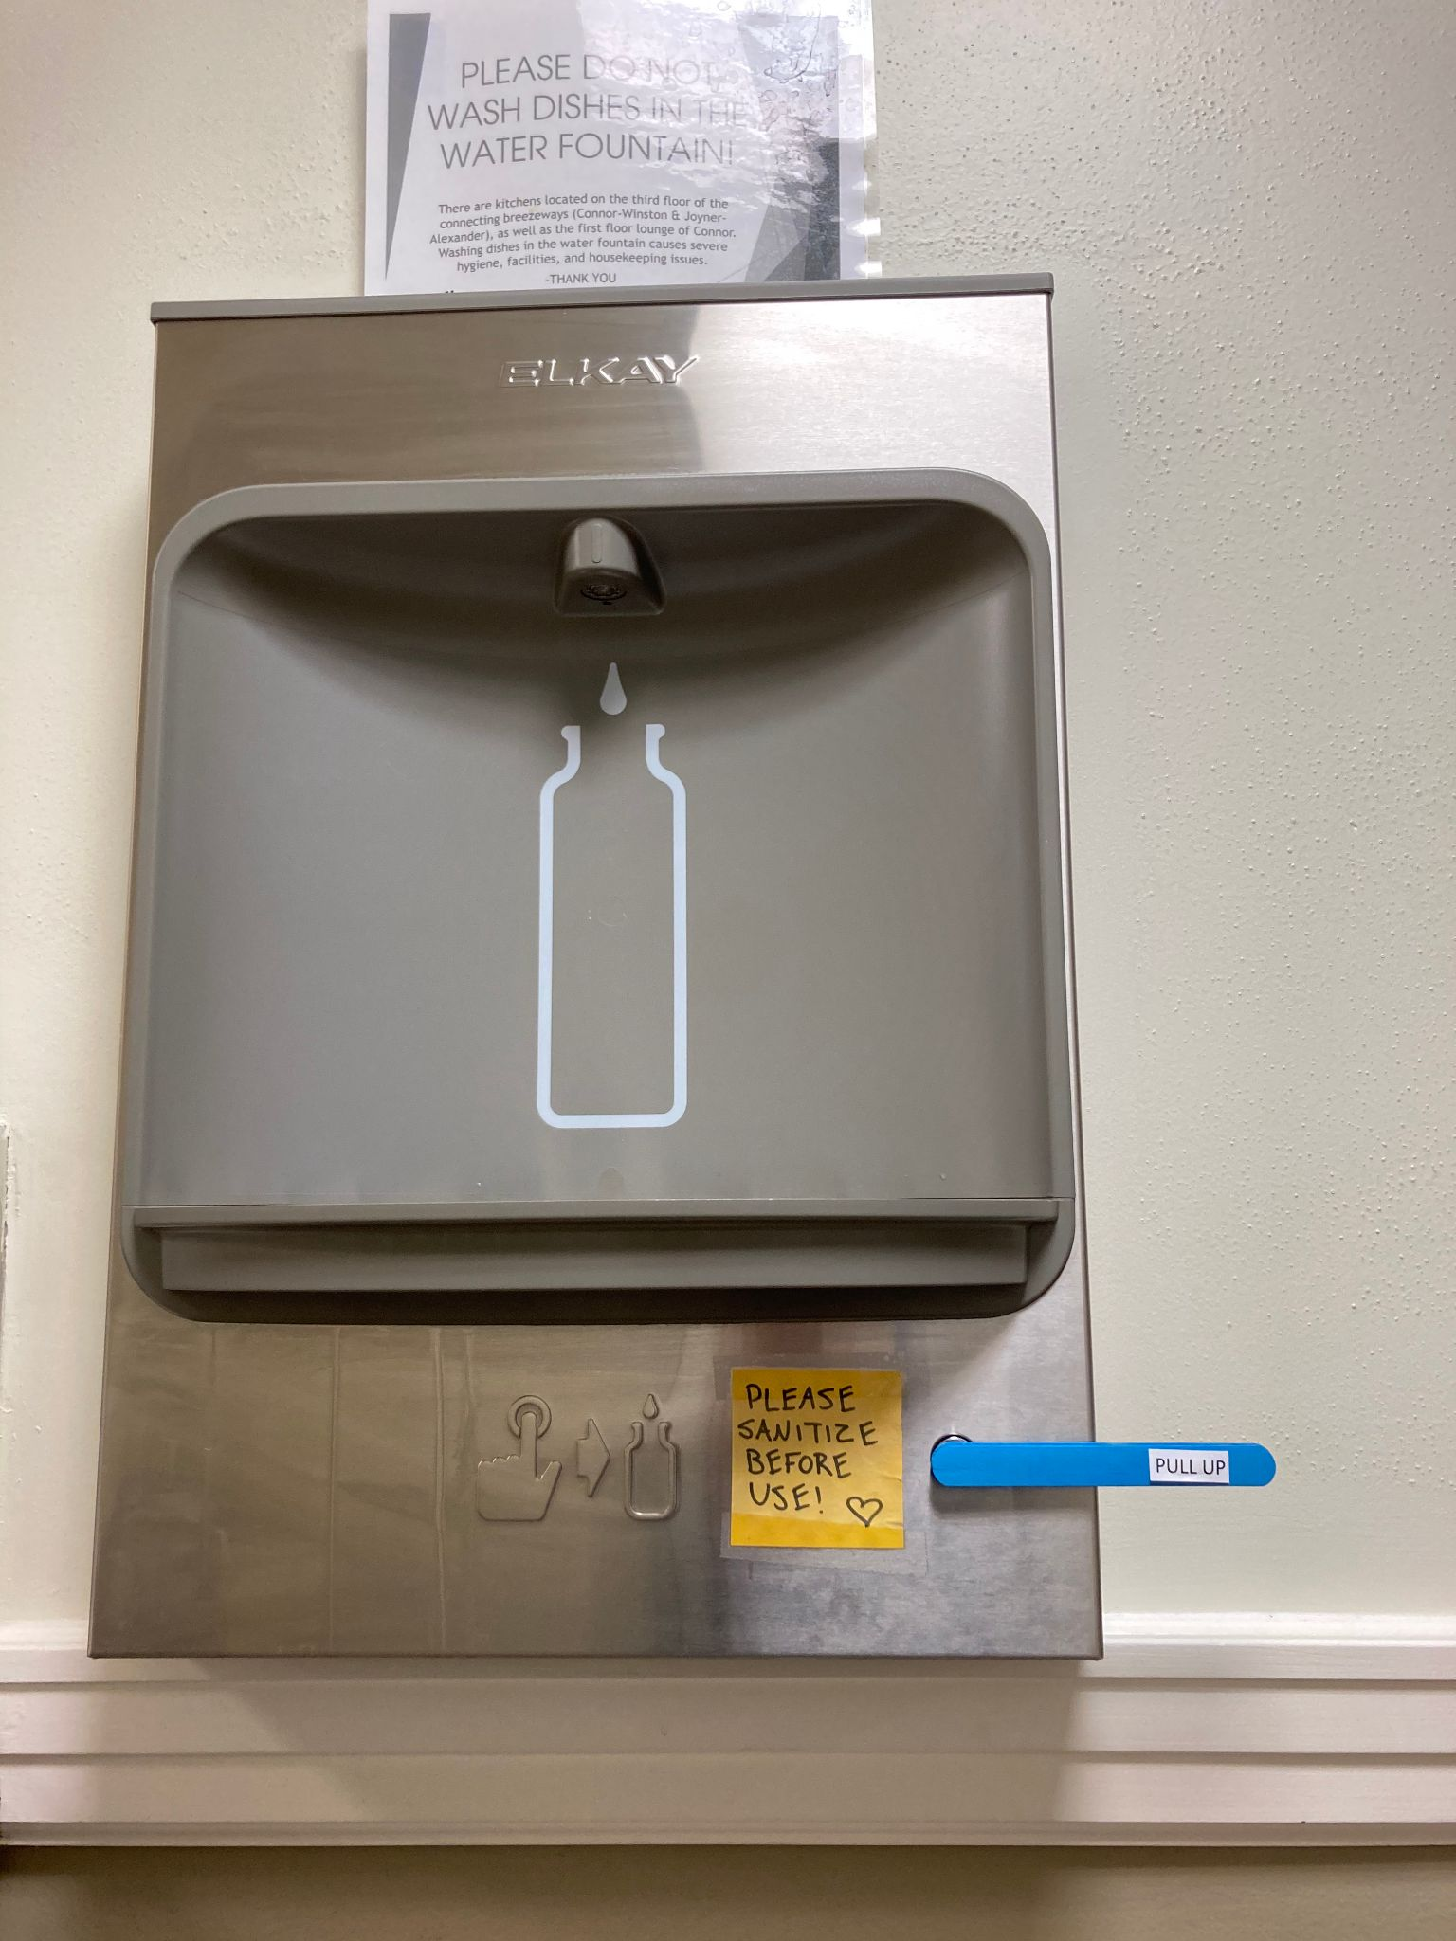
Final Prototype

Slide 4
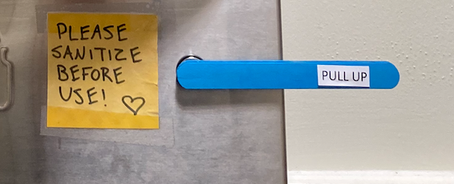
Features
3 popsicle sticks from Makerspace kit painted Carolina blue and hot-glued together
Attached to bottle filler with adhesive strip
Layered popsicle sticks are strong enough to press button without breaking
Sign on bar gives instructions for use
Bar works as a lever, reducing the force needed to press the button by increasing distance (pulling upwards).
Challenge 2
Challenge 3

Slide 5

Demonstration
Challenge 2
Challenge 3
To work the button-pusher, grasp the popsicle sticks, place thumb on center, and pull outward.

Slide 6
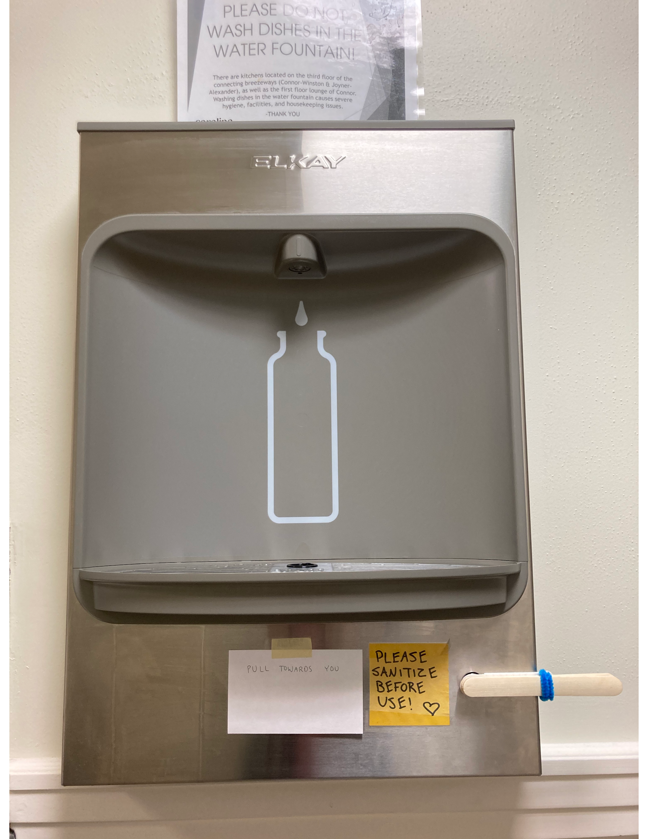
Better than before: Prototypes
Prototype 1
Final Prototype

Slide 7
Better than before: Design Feedback
Feedback Summary from Prototype 1
Prototype 2 Features
Increase color coverage
Use Carolina blue to match target market, students at UNC
For simplicity, get rid of blue pipe cleaner
Glue sticks together to make a single bar
Put instructions for use on the bar to eliminate need for a sign
Make written instructions larger
Paint sticks Carolina blue
Hot-glue sticks together
Attach printed sign to bar, not bottle filler

Slide 8
Better than Before: Function
Prototype 1 adhesive: command strip
Final Prototype adhesive: semi-permanent adhesive
In the prototype 1 video, viewers can hear the command strip crackling and nearly coming apart. This occurs right before the second trial. In the final prototype video, the adhesive is so strong that it rattles the front of the bottle filler!

Slide 9
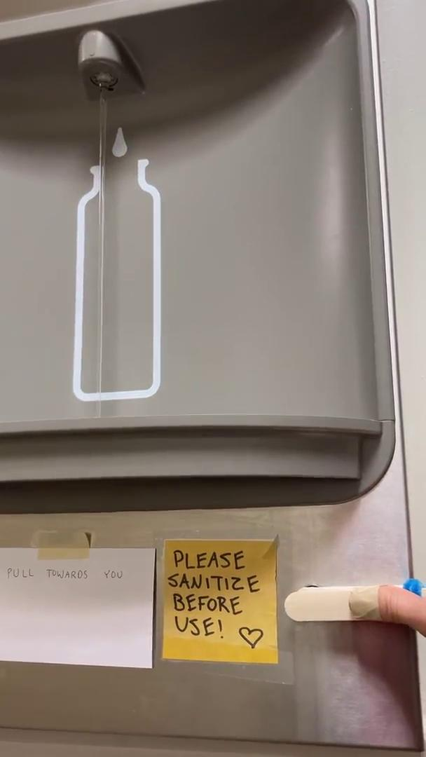
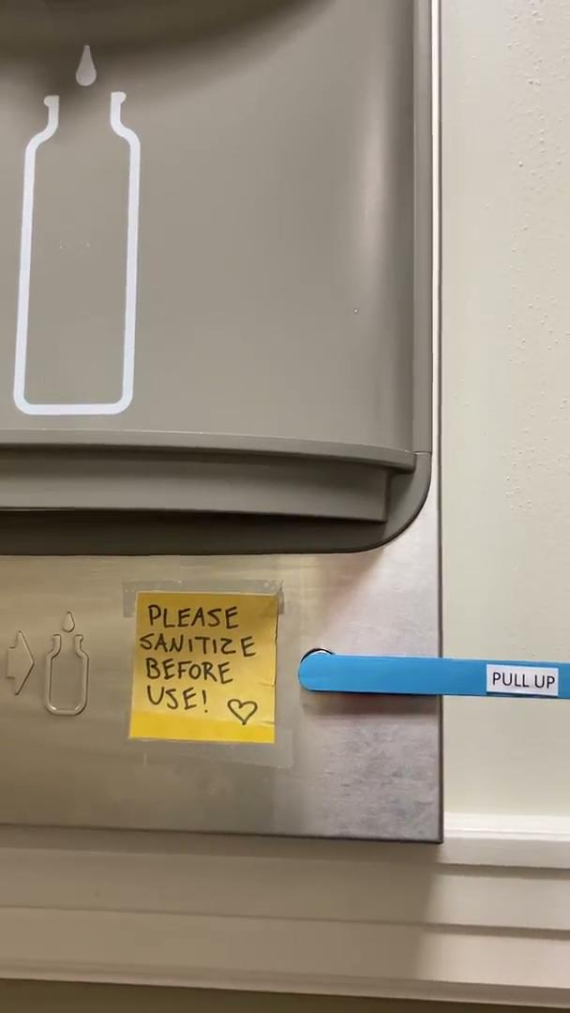
Prototype 1
Final Prototype

